Slide 1
Presentation on: Virtual Machine Deployment and Management (VPC for 2 different OS ECS, Configurations and IMS)
Cloud Computing

Slide 2


﷽
Group 2 Members:
1-Usama Shehzad
2-Basharat Hussain
3-Hassan Farid
4-Muzamil Saeed
5-Noor Danish
6-Wakeel

Slide 3
Summary and Table of Contents
Introduction to VPC for Two OS ECS (Elastic Cloud Server)
Creating an ECS Instance
Selecting ECS Flavor and Specifications
Operating System Configuration
Network Configuration
Resizing the ECS Instance
Using the Command Line Interface (CLI) for ECS
Basic ECS Management Operations (Firewall, Deep Seak, & Remote Services
IMS or Image management services

Slide 4
Introduction to ECS
ECS stands for Elastic Cloud Server
It is a virtual machine hosted in the cloud
Works like a physical computer, but more flexible & scalable.
You can:
Choose your OS (Windows/Linux)
Set your own CPU, RAM, and storage
Configure network settings

Slide 5
ECS
Commonly used for:
Hosting websites and apps
Running software
Testing and development
Data storage in the cloud

Slide 6
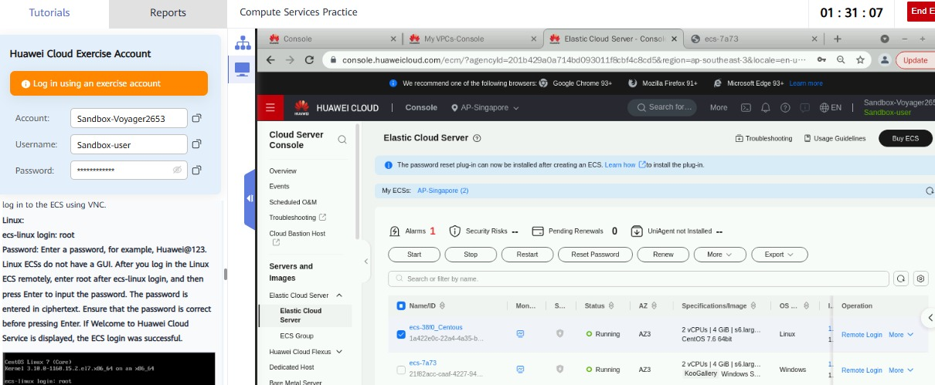
Creating ECS Servers for Windows and Linux After VPC

Slide 7
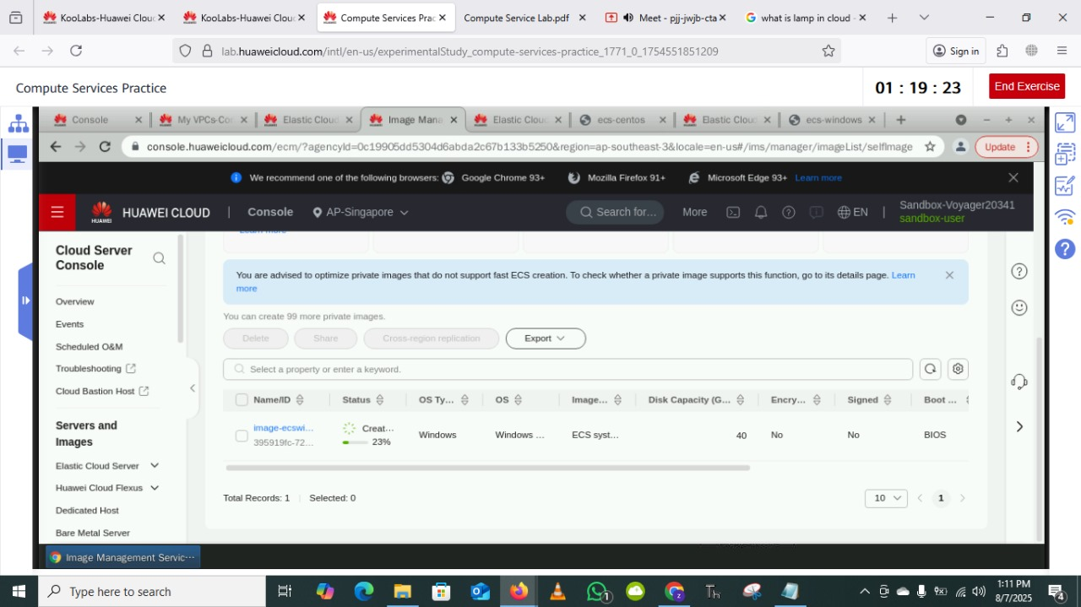
ECS Creation

Slide 8
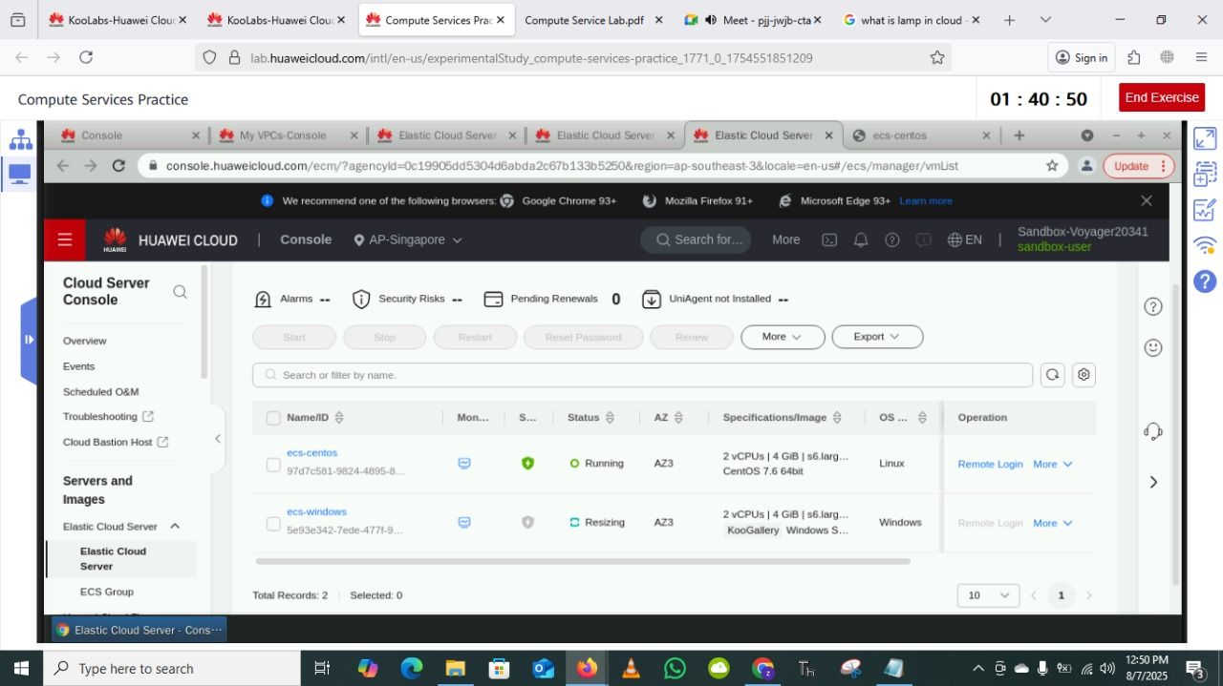
Elastic Cloud Server Resizing

Slide 9
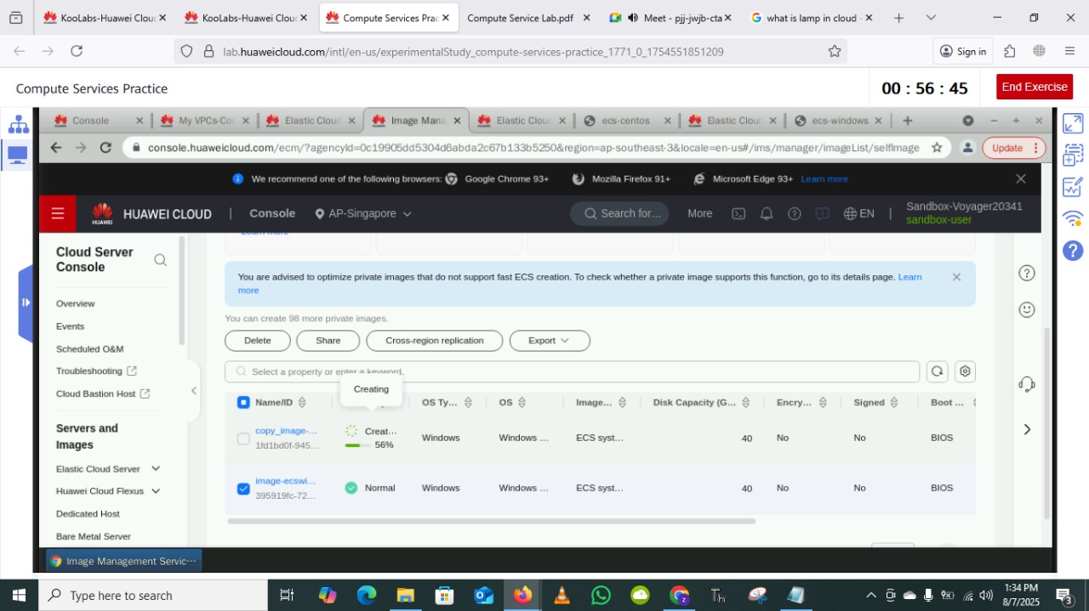
Creating ECS Image for Window

Slide 10
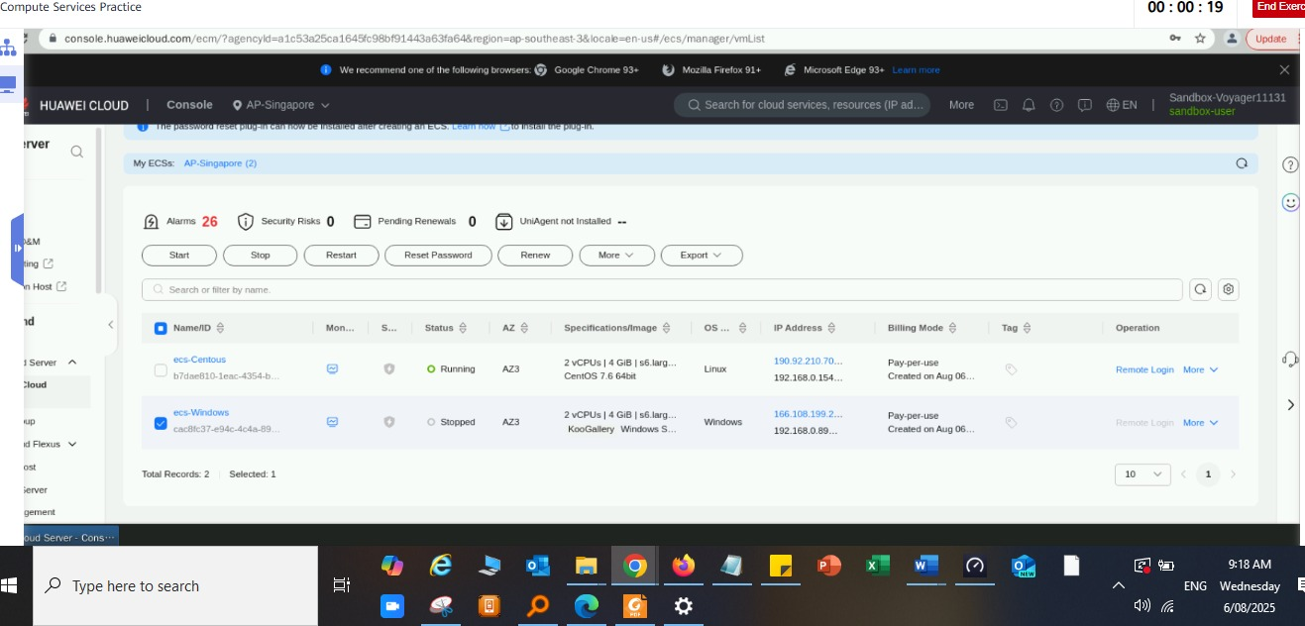
Stop and Modify ECS

Slide 11
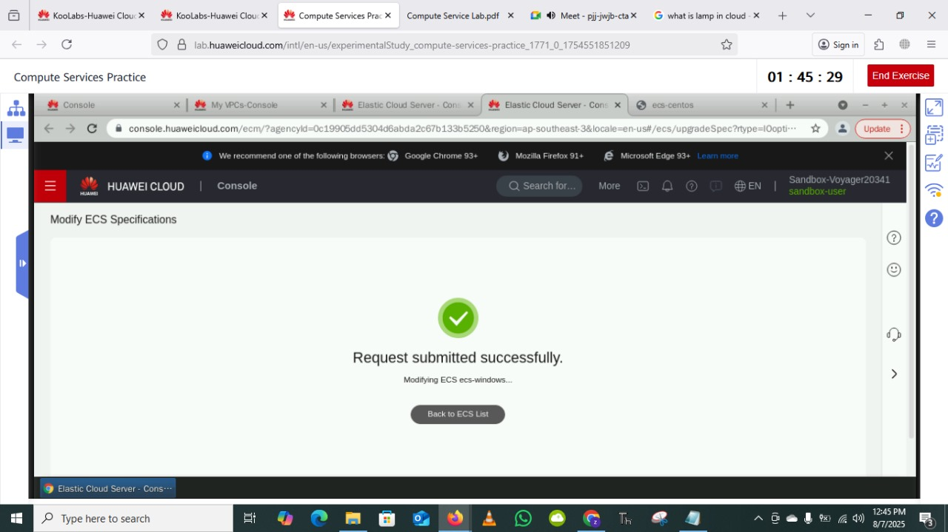
ECS Modification Request Submitted

Slide 12
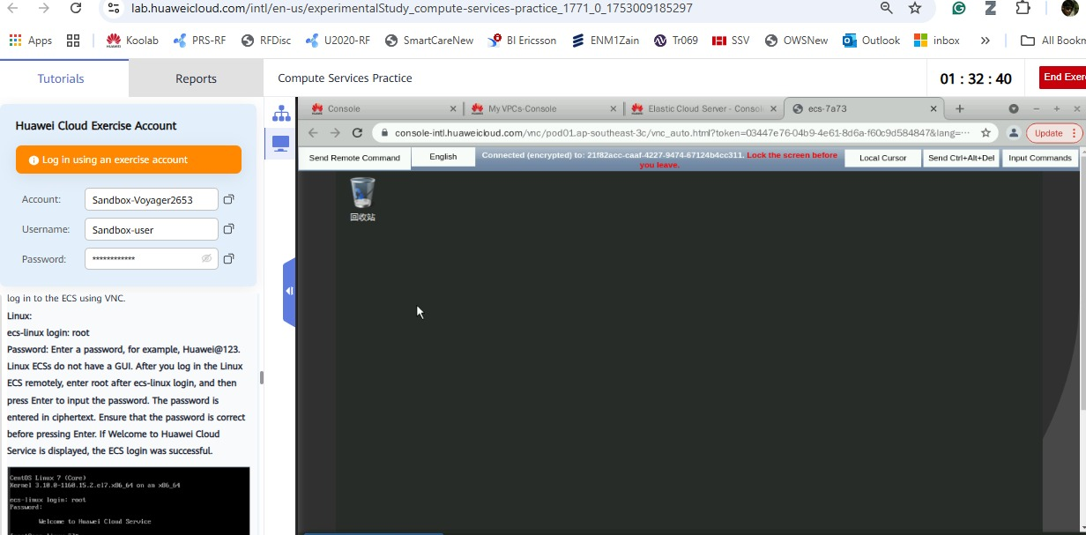
Login VNC for Windows to config Firewall and Remote Services

Slide 13
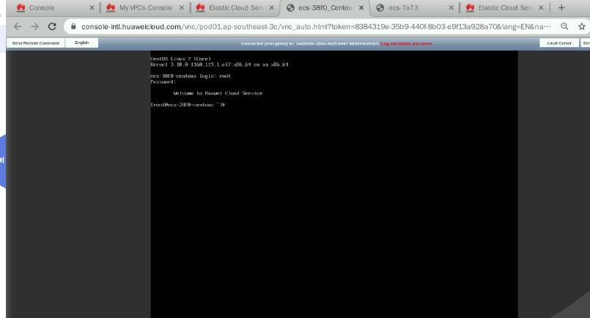
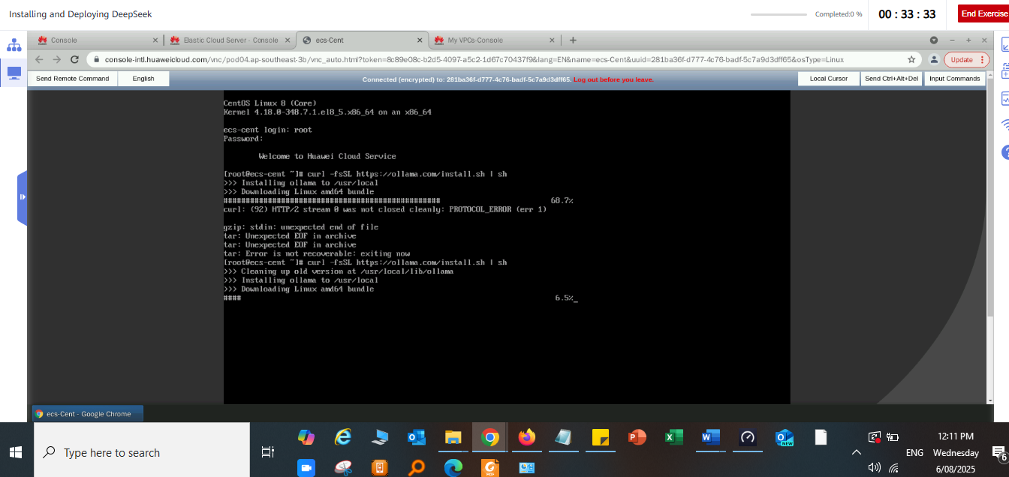
CLI Login Via VNC deploying DeepSeak

Slide 14
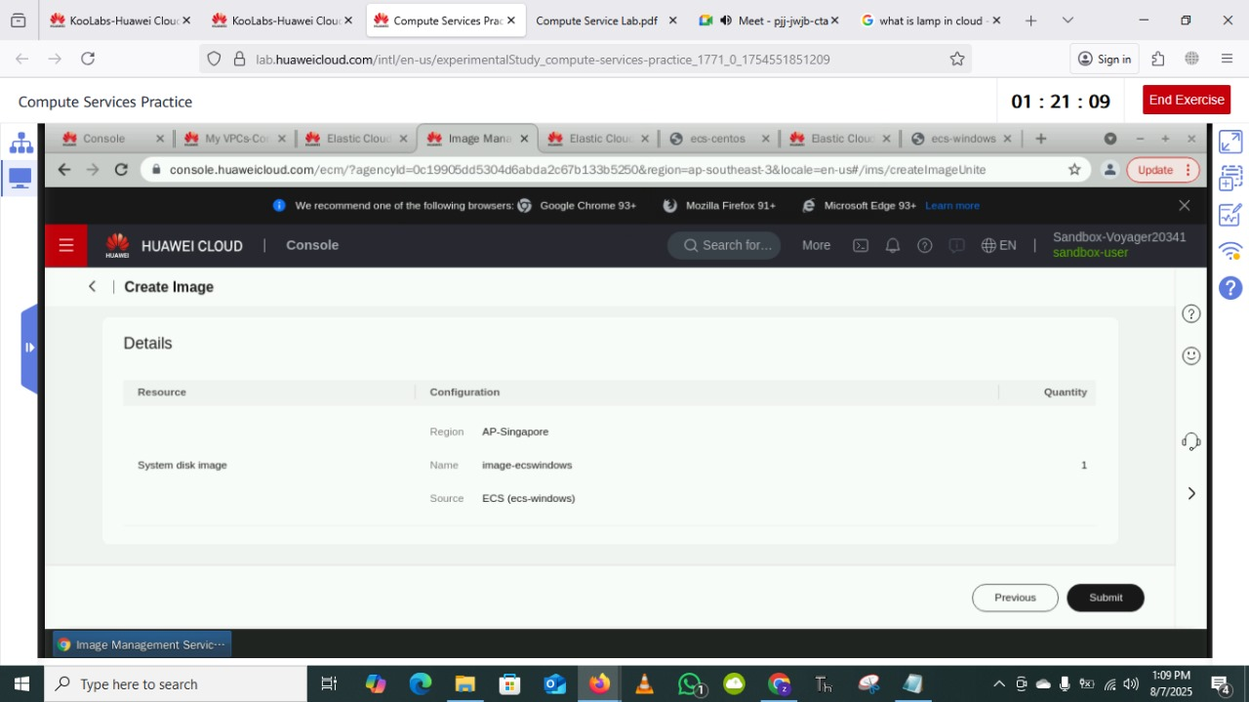
IMS:Image management Service – Create an Image

Slide 15
IMS Image management system – Creation InProgress

Slide 16
IMS Image management system – Create InProgress

Slide 17
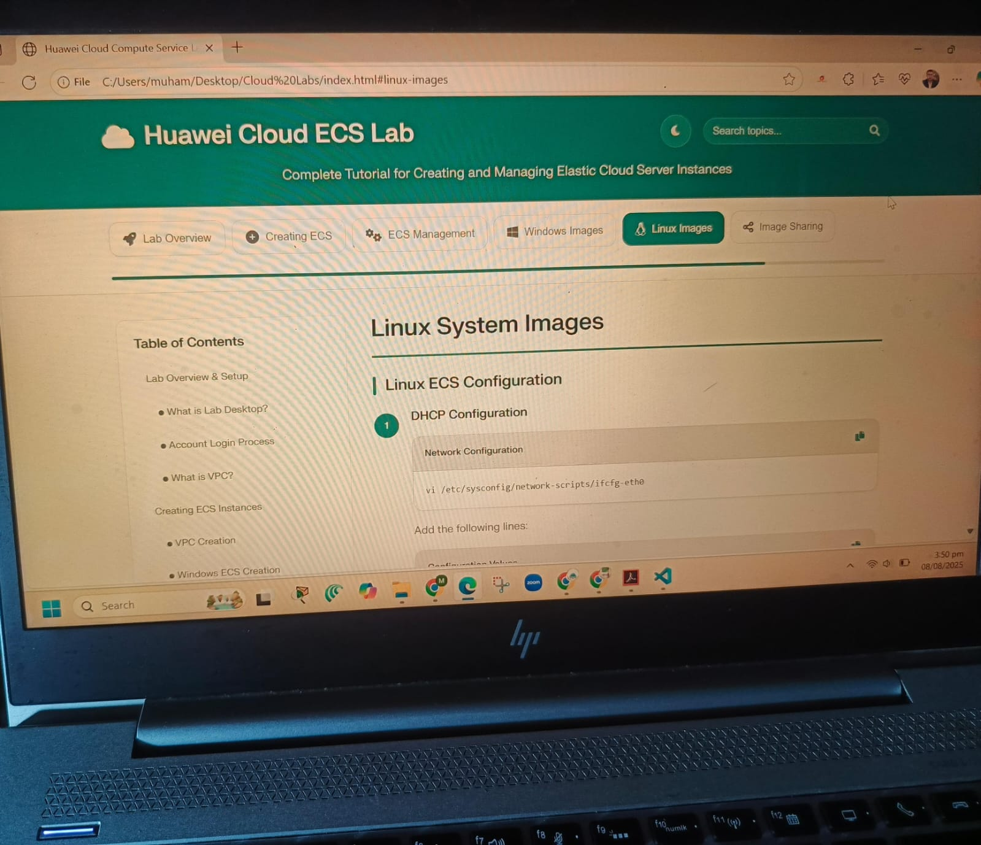
Cloud ECS Lab – Image management for Linux

Slide 18
Conclusion:
To create and VPC and then 2 ECS Instances for different OS
Learn how to Deploy and modify required resources
Storage solutions (VPC ECS, EVS & OBS)
Configuration and installations on different OS on ECS
Linux, CentOS , Sun Solaris, SUSE Linux, RHEL, Fedora , Windows
IMS or Image management services for different Specification
Mount Images on servers to access and deploy ECS instantly with required configuration (Customize templates, life cycles and Identical ECS)

Slide 19


